Slide 1

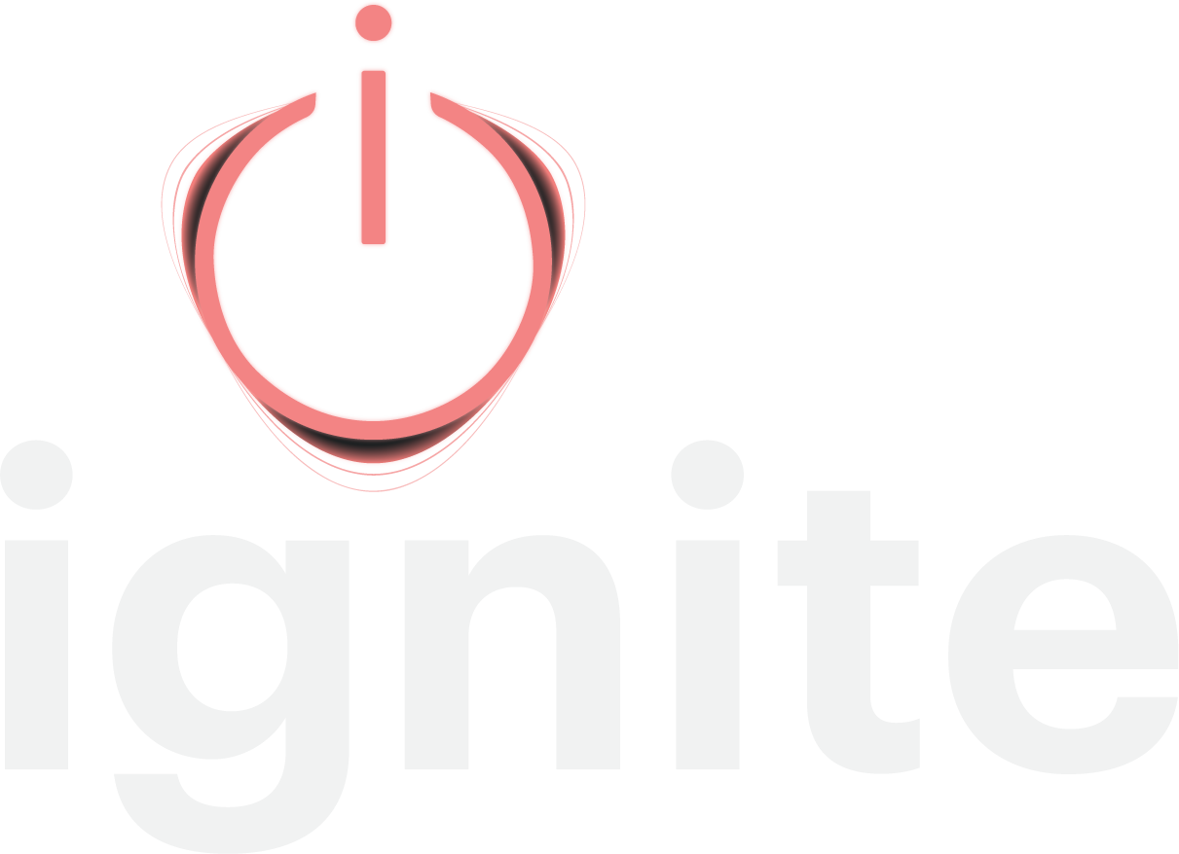
The agentic platform
for revenue strategy
Your team sees the market shift months before the field can act on it. Ignite closes that gap, from first signal to a working playbook.
do less. make it mean more.
THE PROBLEM
It is not a strategy failure. It is an operationalization problem.
Most leaders see the shift coming. Then the strategy travels from the leadership team to the sales, marketing, and revenue people at each property, and it lands as the same 30-60-90 day task list they have always run. Good people, good tools. The strategy gets lost on the way down.
3 months
at best, from spotting a trend to executing on it. Results take longer.
30-60-90
day task lists in the field, the same as they have always been
15.5 hours
per hotel, at a management group, on a plan that was never used
$1.3M to $2M
estimated missed revenue in one 100-room asset in a tertiary market
WHAT IGNITE DOES
Agentic, because it does the structuring work. Continuous, not episodic.
Spots the quake
A shift in demand, a segment, a feeder market, or a competitor's move, before it hits your numbers.
Builds the roadmap
Built on a decade of revenue strategy work, not a blank page.
Deploys the playbook
Deployed to the field, ranked by revenue and profit together.
Plenty of AI makes the task list faster. Ignite decides what belongs on it, then tracks which moves show up in the number, so the owner conversation runs on proof. It sits above your RMS, never in place of it.
STRATEGY BETA GROUP
$20,000 per account. Three to five members.
Not investors. Cash for access, not equity for access. Each member commits several properties and defines success in writing, in their own numbers, before day one.
THE CHARTER RATE
20% under list for three years.
After general availability, on every property you bring on, not just the beta ones. Onboarding waived. Does not stack with other multi-year discounts. Offered once, to this first group.
WHAT MEMBERS GET
• Ignite across your committed properties
• A direct hand in the multi-property build
• Your portfolio's patterns in the engine first
• Kate Burda & Company alongside your team
STRAIGHT TALK ON FUSE
Ignite is live. Fuse, the multi-property layer, is not built yet.
We are building it now, with the members who will run it.
MEET THE CORE TEAM
Kate Burda, Founder. Eddie Westerfield, CTO. Recardo Poole, UI/UX. Tristan Carty, Operations.
Kate brings 28+ years in revenue strategy. Four builders, so three to five members, not thirty.
NEXT STEP 45 minutes. Nothing required from your side.
Watch Ignite run on Flying Horse Resort & Club's live data, with their permission,
or on public data from your own market. Somebody else's numbers first, then yours.

